Slide 1
Database Applications Relational Algebra

Slide 2
Relational Query Languages
Languages for describing queries on a relational database
Structured Query Language (SQL)
Predominant application-level query language
Declarative
Relational Algebra
Intermediate language used within DBMS
Procedural

Slide 3
What is an Algebra?
A language based on operators and a domain of values
Operators map values taken from the domain into other domain values
Hence, an expression involving operators and arguments produces a value in the domain
When the domain is a set of all relations (and the operators are as described later), we get the relational algebra
We refer to the expression as a query and the value produced as the query result

Slide 4
Relational Algebra
Domain: set of relations
Basic operators: select, project, union, set difference, Cartesian product
Derived operators: set intersection, division, join
Procedural: Relational expression specifies query by describing an algorithm (the sequence in which operators are applied) for determining the result of an expression

Slide 5
Relational Algebra
Formalism for creating new relations from existing ones
Its place in the big picture:
Declartive query language
Algebra
Implementation
SQL, relational calculus
Relational algebra Relational bag algebra

Slide 6
Relational Algebra
Procedural language
Six basic operators
select: σ
project: ∏
union: ∪
set difference: –
Cartesian product: x
rename: ρ
The operators take one or two relations as inputs and produce a new relation as a result.

Slide 7
Select Operation
Notation: σ _{p}(r)
p is called the selection predicate
Defined as: σ_{p}(r) = {t | t ∈ r and p(t)}
Where p is a formula in propositional calculus consisting of terms connected by : ∧ (and), ∨ (or), ¬ (not) Each term is one of:
<attribute> op <attribute> or <constant>
where op is one of: =, ≠, >, ≥. <. ≤
Example of selection: σ _{dept_name=“Physics”}(instructor)

Slide 8
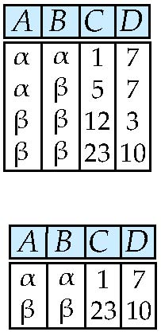
Select Operation – Example
Relation r
σ_{A=B ^ D > 5} (r)

Slide 9
The Selection Operation
Example:
Input Relation:
Output Relation:
S2

Slide 10
Project Operation
Notation:
where A₁, A₂ are attribute names and r is a relation name.
The result is defined as the relation of k columns obtained by erasing the columns that are not listed
Duplicate rows removed from result, since relations are sets
Example: To eliminate the dept_name attribute of instructor ∏_{ID, name, salary} (instructor)

Slide 11
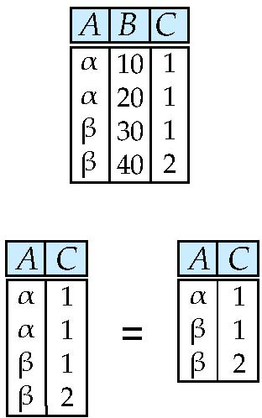
Project Operation – Example
Relation r:
∏_{A,C} (r)

Slide 12
Operator Composition
The output relation can be the input for another relational algebra operation! (Operator composition)
Example:
Input Relation:
Intermediate Relation:
Final Output Relation:
S2

Slide 13
Project Operation Expressions
π _{Id, Name} (σ Hobby=’stamps’ OR Hobby=’coins’ (Person) )
Id Name Address Hobby Id Name
1123 John 123 Main stamps
1123 John 123 Main coins
5556 Mary 7 Lake Dr hiking
9876 Bart 5 Pine St stamps
1123 John
9876 Bart
Result
Person

Slide 14
Union Operation
Notation: r ∪ s
Defined as:
r ∪ s = {t | t ∈ r or t ∈ s}
For r ∪ s to be valid.
1. r, s must have the same number of attributes
2. The attribute domains must be compatible (example: 2nd column of r deals with the same type of values as does the 2nd column of s)
Example: to find all courses taught in the Fall 2009 semester, or in the Spring 2010 semester, or in both ∏_{course_id} (σ _{semester=“Fall” Λ year=2009} (section)) ∪ ∏_{course_id} (σ _{semester=“Spring” Λ year=2010} (section))

Slide 15
Union Compatible Relations
Two relations are union compatible if
Both have same number of columns
Names of attributes are the same in both
Attributes with the same name in both relations have the same domain
Union compatible relations can be combined using union, intersection, and set difference

Slide 16
Example
Tables:
Person (SSN, Name, Address, Hobby)
Professor (Id, Name, Office, Phone)
are not union compatible.
But
π _{Name} (Person) and π _{Name} (Professor)
are union compatible so
π _{Name} (Person) - π _{Name} (Professor)
makes sense.

Slide 17
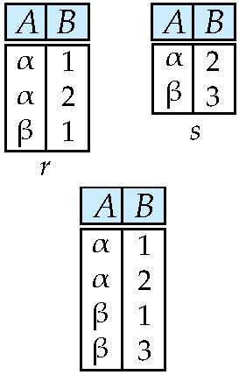
Union Operation – Example
Relations r, s:
r ∪ s:

Slide 18
Set Difference Operation
Notation r – s
Defined as:
r – s = {t | t ∈ r and t ∉ s}
Set differences must be taken between compatible relations.
r and s must have the same arity
attribute domains of r and s must be compatible
Example: to find all courses taught in the Fall 2009 semester, but not in the Spring 2010 semester ∏_{course_id} (σ _{semester=“Fall” Λ year=2009} (section)) − ∏_{course_id} (σ _{semester=“Spring” Λ year=2010} (section))

Slide 19
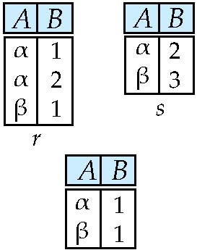
Set difference of two relations
Relations r, s:
r – s:

Slide 20
Cartesian-Product Operation
Notation r x s
Defined as:
r x s = {t q | t ∈ r and q ∈ s}
Assume that attributes of r(R) and s(S) are disjoint. (That is, R ∩ S = ∅).
If attributes of r(R) and s(S) are not disjoint, then renaming must be used.

Slide 21
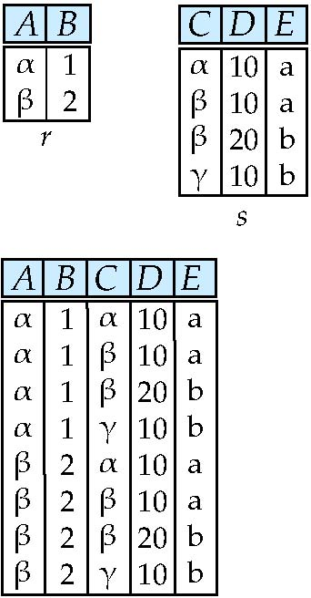
Cartesian-Product Operation – Example
Relations r, s:
r x s:

Slide 22
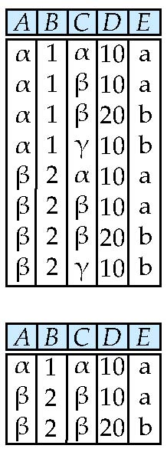
Composition of Operations
Can build expressions using multiple operations
Example: σ_{A=C}(r x s)
r x s
σ_{A=C}(r x s)

Slide 23
Rename Operation
The RENAME operation is used to rename the output of a relation
Reasons to rename a relation can be many, like –
We may want to save the result of a relational algebra expression as a relation so that we can use it later.
We may want to join a relation with itself, in that case, it becomes too confusing to specify which one of the tables we are talking about, in that case, we rename one of the tables and perform join operations on them.
Notation:
ρ _{X} (R)
where the symbol ‘ρ’ is used to denote the RENAME operator and R is the result of the sequence of operation or expression which is saved with the name X.
Example: Query to rename the attributes Name, Age of table Department to A,B.
ρ _{(A, B)} (Department)
Query to rename the table name Project to Pro and its attributes to P, Q, R.
ρ _{Pro(P, Q, R)} (Project)

Slide 24
Rename Operation
Example : Query to rename the relation Student as MaleStudent and the attributes of Student – RollNo, SName as (Sno, Name).
ρ _{MaleStudent(Sno, Name)} π_{RollNo, SName}(σ_{Condition}(Student))
Sno Name
2600 Ali
2655 Raja

Slide 25
Example Query
Find the largest salary in the university
Step 1: find instructor salaries that are less than some other instructor salary (i.e. not maximum)
using a copy of instructor under a new name d
∏_{instructor.salary} (σ _{instructor.salary < d.salary} (instructor x ρ_{d} (instructor)))
Step 2: Find the largest salary
∏_{salary} (instructor) – ∏_{instructor.salary} (σ _{instructor.salary < d.salary} (instructor x ρ_{d} (instructor)))

Slide 26
Example Queries
Find the names of all instructors in the Physics department, along with the course_id of all courses they have taught
Relation instruct
ID | Name | Dept_name
10101 | Ali | Computer
12121 | Jawad | Physics
15151 | Mona | Physics
Relation teaches
ID | Course_id
10101 | CS-101
12121 | Ph-101
12121 | Ph-201
15151 | Ph-401
Query ∏_{instructor.ID,course_id} (σ_{dept_name=“Physics”} ( σ _{instructor.ID=teaches.ID} (instructor x teaches)))

Slide 27
Formal Definition
A basic expression in the relational algebra consists of either one of the following:
A relation in the database
A constant relation
Let E₁ and E₂ be relational-algebra expressions; the following are all relational-algebra expressions:
E₁ ∪ E₂
E₁ – E₂
E₁ x E₂
σ_{p} (E₁), P is a predicate on attributes in E₁
∏_{s}(E₁), S is a list consisting of some of the attributes in E₁
ρ _{x} (E₁), x is the new name for the result of E₁

Slide 28
Additional Operations
We define additional operations that do not add any power to the
relational algebra, but that simplify common queries.
Set intersection
Natural join
Assignment
Outer join

Slide 29
Set-Intersection Operation
Notation: r ∩ s
Defined as:
r ∩ s = { t | t ∈ r and t ∈ s }
Assume:
r, s have the same arity
attributes of r and s are compatible
Note: r ∩ s = r – (r – s)

Slide 30
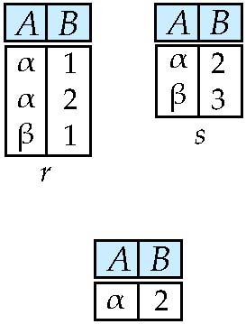
Set-Intersection Operation – Example
Relation r, s:
r ∩ s

Slide 31
Natural-Join Operation
Notation: r s
Let r and s be relations on schemas R and S respectively. Then, r s is a relation on schema R ∪ S obtained as follows:
Consider each pair of tuples t_{r} from r and t_{s} from s.
If t_{r} and t_{s} have the same value on each of the attributes in R ∩ S, add a tuple t to the result, where
t has the same value as t_{r} on r
t has the same value as t_{s} on s
Example:
R = (A, B, C, D)
S = (E, B, D)
Result schema = (A, B, C, D, E)
r s is defined as: ∏_{r.A, r.B, r.C, r.D, s.E} (σ_{r.B = s.B ∧ r.D = s.D} (r x s))

Slide 32
Natural Join
R= S=
R S=
A | B
X | Y
X | Z
Y | Z
Z | V
B | C
Z | U
V | W
Z | V
A | B | C
X | Z | U
X | Z | V
Y | Z | U
Y | Z | V
Z | V | W

Slide 33
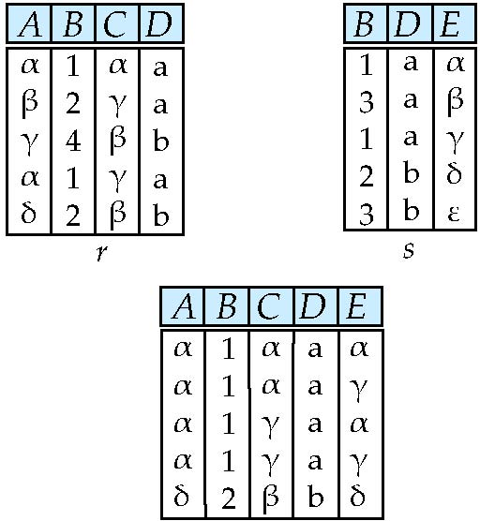
Natural Join Example
Relations r, s:
r s

Slide 34
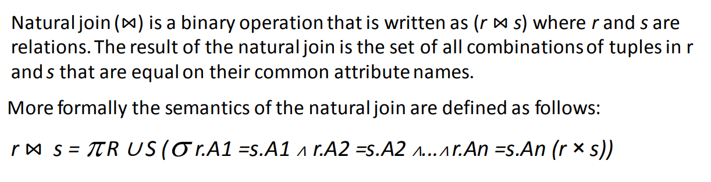
Natural-Join Operation

Slide 35
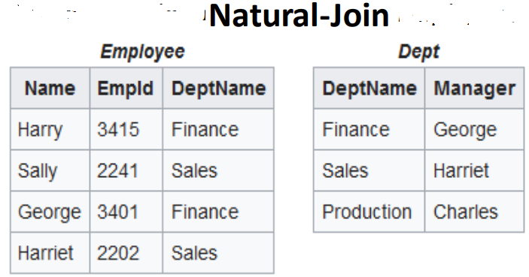

Slide 36
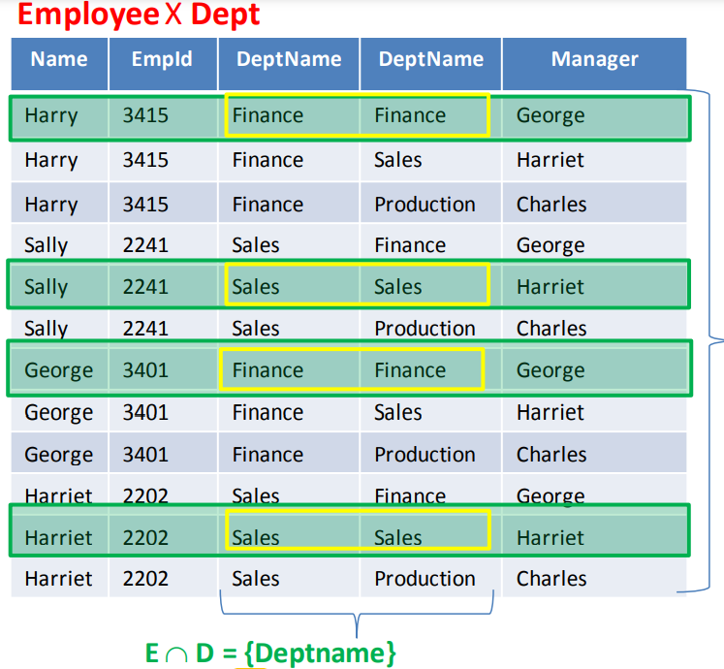

Slide 37
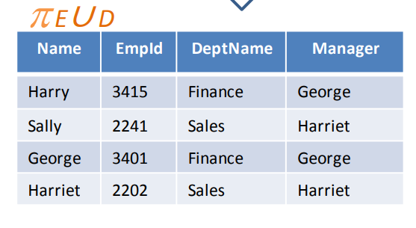

Slide 38
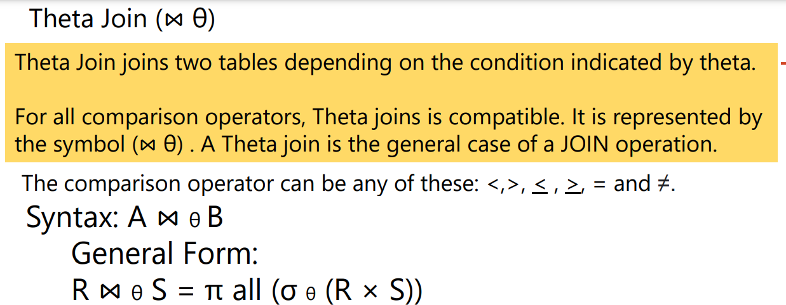

Slide 39
Theta Join cont.
(Theta) Join :
The schema of the output relation is the same as that of cross-product
It usually includes fewer tuples than cross-product
Example:
Input Relations:
Output Relation:
S1
R1
Will be redundant “if” the condition is S1.sid = R1.sid!

Slide 40
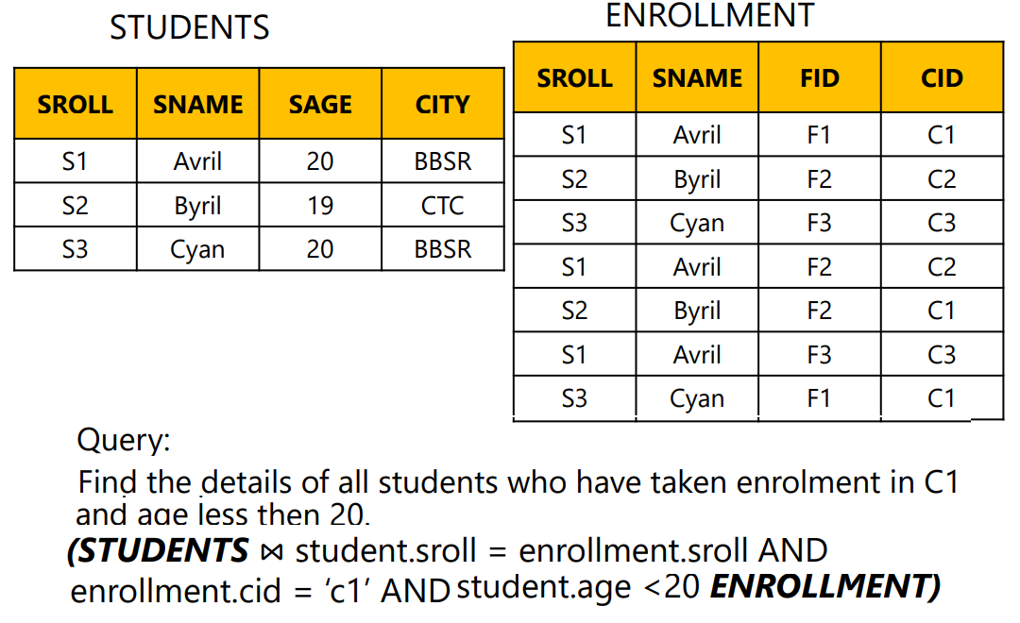

Slide 41
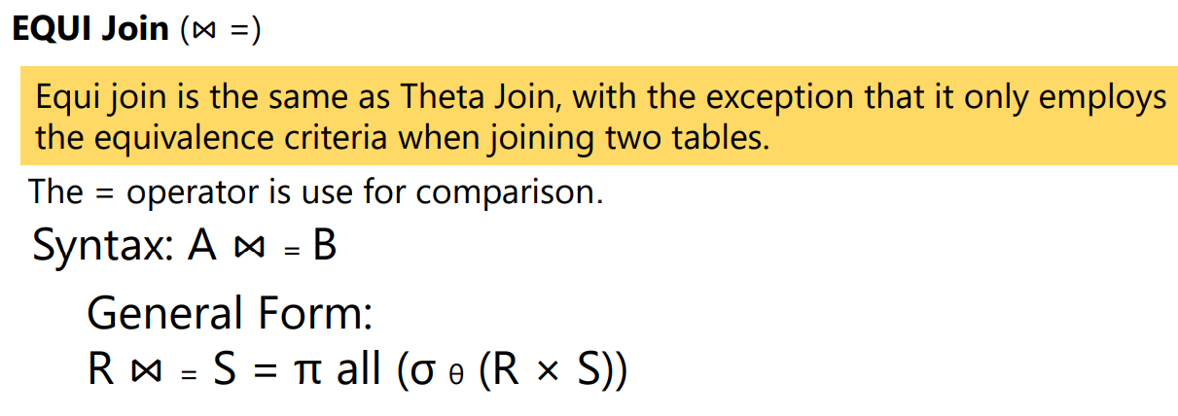

Slide 42
Eq-join cont.
Equi-Join:
A special case of theta join where the condition c contains only equalities
The schema of the output relation is the same as that of cross-product, “but only one copy of the fields for which equality is specified”
Example:
Input Relations:
Output Relation:
S1
R1
ONLY one sid column!

Slide 43
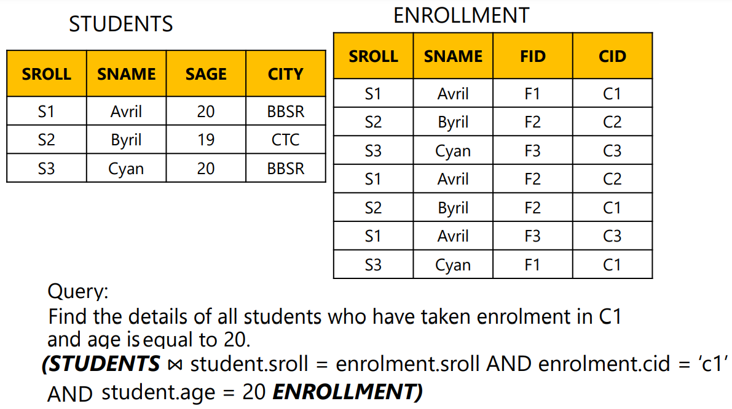

Slide 44
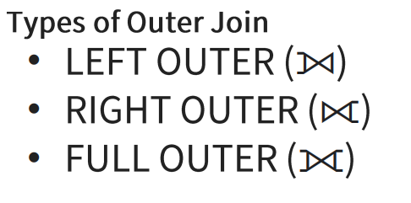
OUTER JOIN
The outer join in Relational algebra returns all the characteristics of both tables. If an attribute value is not present for any of the tables, it returns NULL in the table attribute's relevant row

Slide 45
LEFT OUTER Join (⟕)
The resultant relation contains all of the tuples from the Left relation, R. If there are tuples in R that do not have a corresponding tuple in the Right relation S, the S-attributes of the resultant relation are set to NULL
_{Syntax: A ⟕B}
All information from the left relation is present in the result of the left outer join

Slide 46
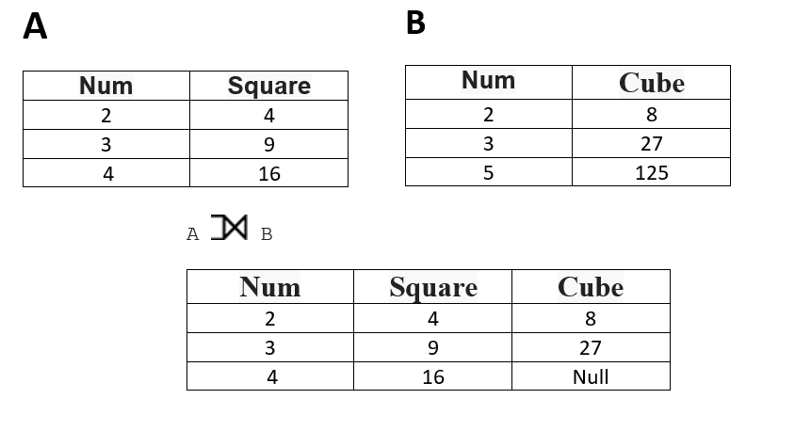
LEFT OUTER Join (⟕)

Slide 47
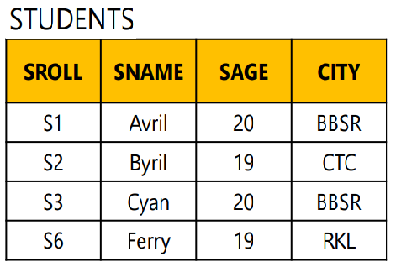
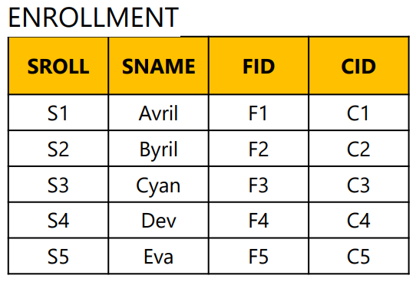
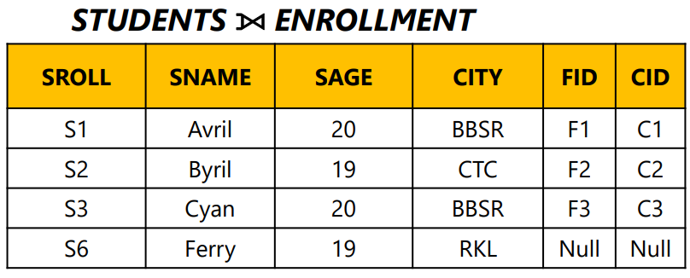

Slide 48
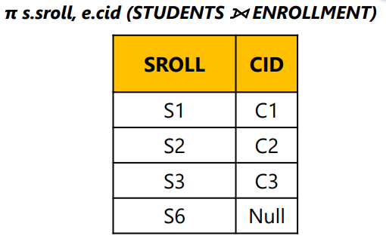
LEFT OUTER Join (⟕)
Find the details of students who have taken enrolment and who have no

Slide 49
RIGHT OUTER Join (⟖)
The resultant relation contains all of the tuples from the Right relation, S.
If there are tuples in S that do not have a corresponding tuple in R, the R-attributes of the resultant relation are set to NULL
_{Syntax: A ⟖ B}
All information from the right relation is present in the result of the right outer join

Slide 50
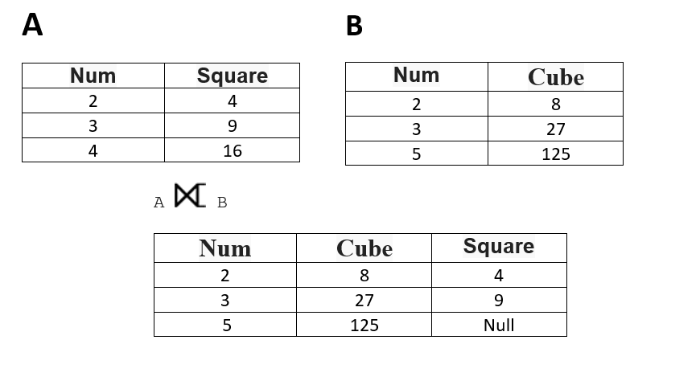
RIGHT OUTER Join (⟖)

Slide 51
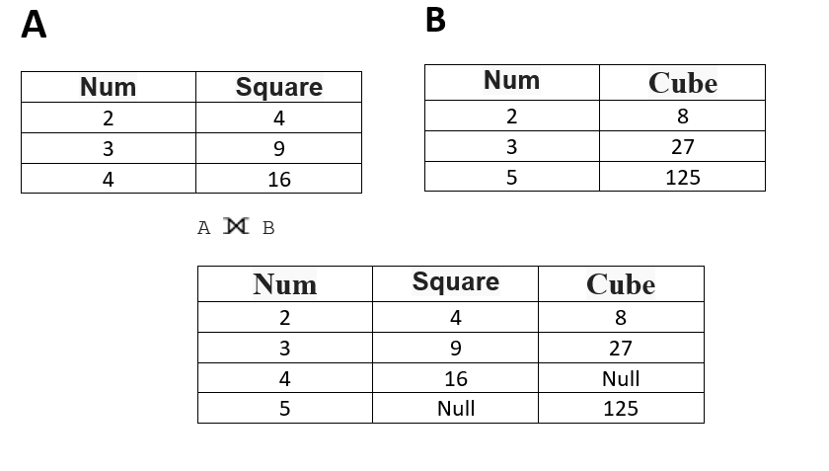
Full Outer Join ( A ⟗ B)
In a full outer join, all tuples from both relations are included in the result

Slide 52
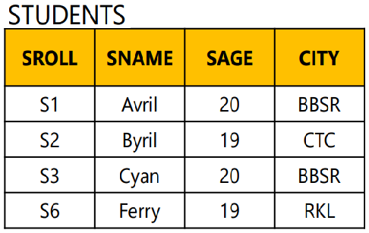
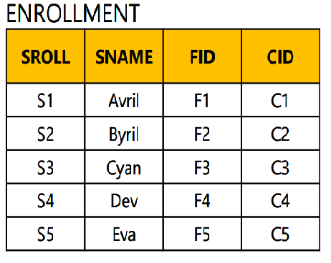
Full Outer Join ( A ⟗ B)

Slide 53
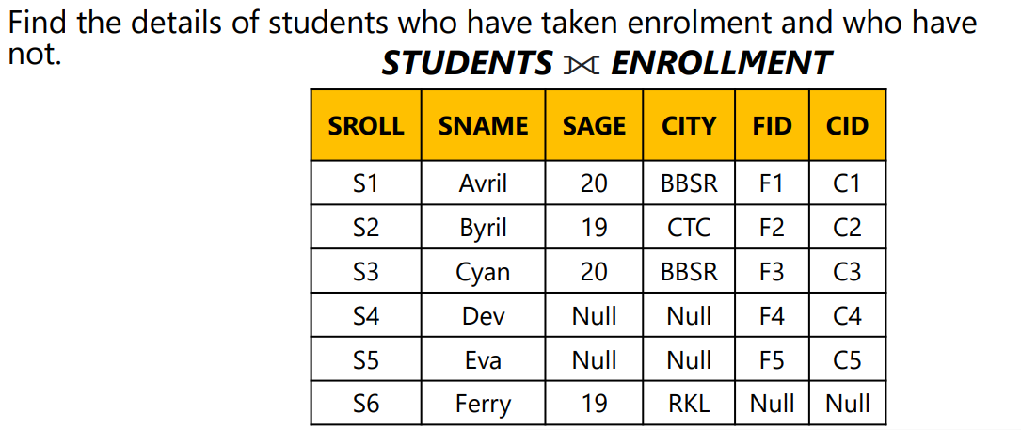
Full Outer Join ( A ⟗ B)

